Slide 1
Making graphs in R - GGPLOT2
Juan Mejia
jmejiare@chicagobooth.edu

Slide 2
Agenda
What is Tidyverse?
What is GGPLOT2?
GGPLOT Usage Basics
GGPLOT Graphic Template
GGPLOT Components Explained
Proceed to R Markdown for some examples

Slide 3
What is Tidyverse?
The tidyverse is an opinionated collection of R packages designed for data science. All packages share an underlying design philosophy, grammar, and data structures.
Basically it makes R behave a little bit more like SQL!

Slide 4
What is GGPLOT2?
ggplot2 is a system for declaratively creating graphics, based on The Grammar of Graphics.
You provide the data, tell ggplot2 how to map variables to aesthetics, what graphical primitives to use, and it takes care of the details

Slide 5
# The easiest way to get ggplot2 is to install the whole tidyverse: install.packages("tidyverse") # Alternatively, install just ggplot2: install.packages("ggplot2") # Or the the development version from GitHub: # install.packages("devtools") devtools::install_github("tidyverse/ggplot2")

Slide 6
GGPLOT Usage Basics
In most cases you start with ggplot(), (TOOL)
Supply a dataset (DATA)
Specify an aesthetic (at the very least the x and y variables) (HOW DO I WANT MY DATA TO LOOK)
And then you add on layers such as:
Geometric Objects (TYPE OF CHART)
Stat (MATHEMATICAL OPERATOR)
Position (HOW IS MY DATA PRESENTED - E.G STACKING)
Coordinate Function (WHAT IS THE ORIENTATION OF MY DATA)
Facet function (DATA DIVISIONS)

Slide 7
GGPLOT GRAPHING TEMPLATE
ggplot(data = <DATA>) +
<GEOM_FUNCTION>( mapping = aes(<MAPPINGS>), stat = <STAT>,
position = <POSITION>) + <COORDINATE_FUNCTION> + <FACET_FUNCTION>

Slide 8
ggplot(data = mpg) +
geom_point(mapping = aes(x = displ, y = hwy, color = class, position = “jitter”)) +
labs( x = "engine size", y = "miles per gallon",
title ="Car Efficiency",
subtitle = "Subdivided by class",
caption = "Analytics Group Booth") +
facet_wrap (~year) +
coord_flip()

Slide 9
GGPLOT COMPONENTS EXPLAINED
Geometric Objects
Aesthetic Mappings
Facets
Statistical Transformations (Stat)
Position Adjustments
Coordinate Systems

Slide 10
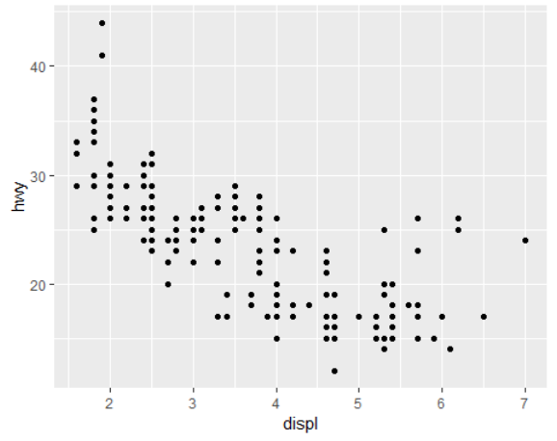
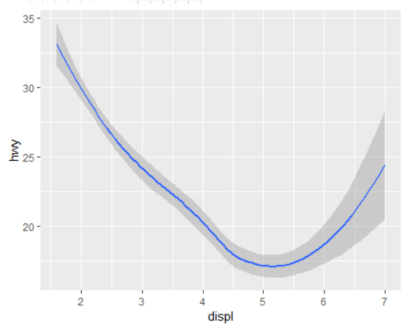
Geometric Objects (GEOMS)
A geom is the geometrical object that a plot uses to represent data.
For example:
Bar charts use bar geoms
Line charts use line geoms
Boxplots use boxplot geoms
Scatterplots break the trend; they use the point geom
https://ggplot2.tidyverse.org/reference/

Slide 11
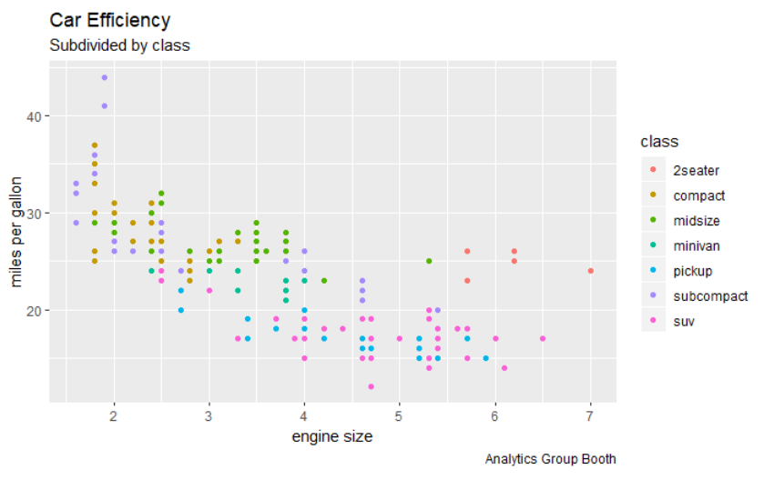
Aesthetic Mappings (aes)
An aesthetic is a visual property of the objects in your plot.
Aesthetics include things like the size, the shape, or the color of your points.
geom_point(mapping = aes(x = displ, y = hwy),color = "blue")

Slide 12
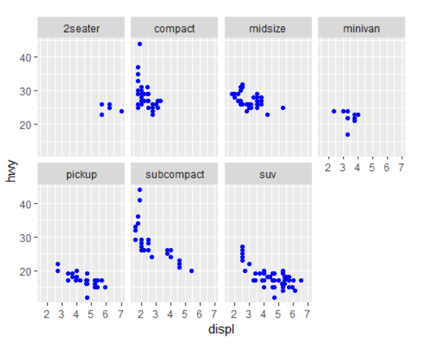
Facets
Facets are a way to add additional variables to your data, by splitting it into subplots! (This is amazing!)
facet_wrap(~ class, nrow = 2)

Slide 13
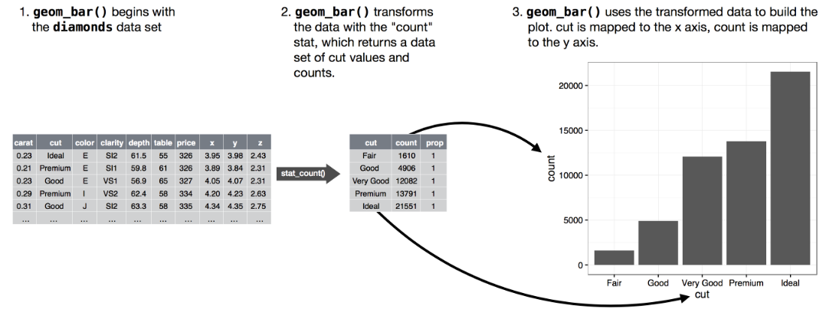
Statistical Transformations (Stats)
Stats are statistical transformations performed by certain GEOM objects such as bar charts! (Confusing, right?)

Slide 14
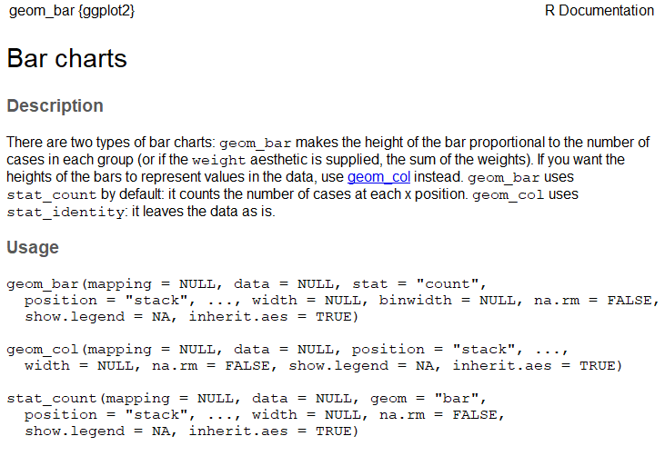
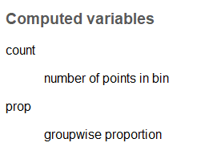
Statistical Transformations (Stats ) - Continued
You can learn which stat a geom uses by inspecting the default value for the stat argument. For example, ?geom_bar shows that the default value for stat is “count”, which means that geom_bar()uses stat_count()

Slide 15
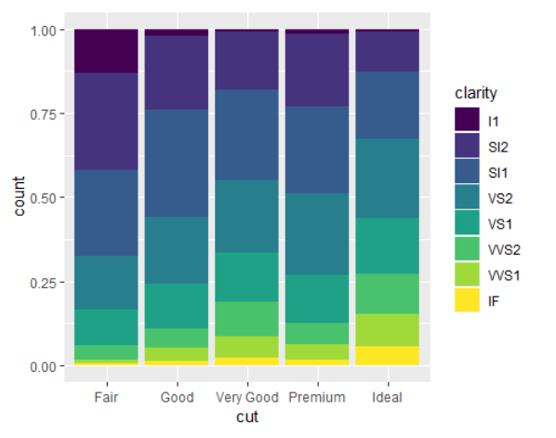
Position Adjustments
Position Adjustments help you view your data more clearly by helping you stack chart, removing or adding noise to a dataset, overplacing objects beside each other, etc

Slide 16
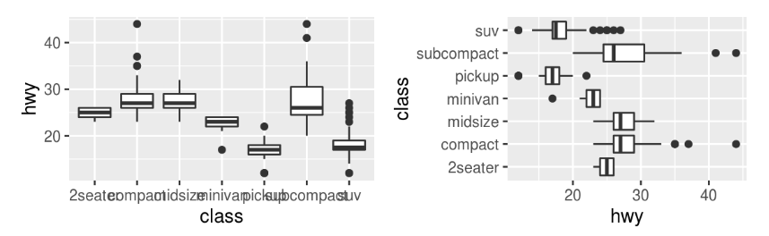
Coordinate Systems
Coordinate systems are probably the most complicated part of ggplot2. The default coordinate system is the Cartesian coordinate system where the x and y positions act independently to determine the location of each point.
I DON’T KNOW MUCH ABOUT THEM ---> BUT…
One coordinate system command is helpful….. COORD_FLIP() switches the x and y axes

Slide 17
Now we will proceed to the RMarkdown!
Important:
Take a look at the mpg and diamonds datasets
A lot of info, we might not have time to go through everything!
If needed we will do one more Visualization workshop (intermediate)

